Slide 1
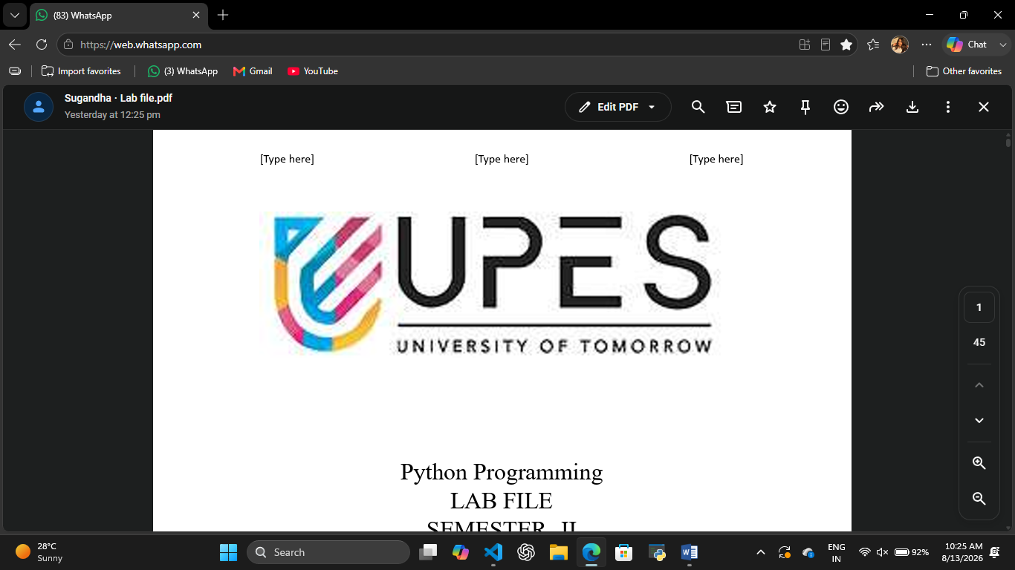
Team Members:
Ishant Painuly – 590037105
Vidhya Tripathi – 590036402
Shreyan Joshi - 590042441
~Mini Hackathon~
SMART CANTEEN BILLING SYSTEM
TEAM - CODEX
Btech. CSE Batch -34

Slide 2
~Introduction~
A canteen serves multiple food items to customers every day.
Preparing bills manually can be time-consuming.
Calculating the cost of multiple items and quantities manually can lead to errors.
Our project provides a simple computerized solution for canteen billing using C.

Slide 3
Objective…
To create a simple menu-driven billing system.
To allow customers to select multiple food items.
To calculate item-wise costs automatically.
To calculate the total bill.
To apply discounts based on the bill amount.
To generate an itemized bill.
To allow multiple independent billing sessions.

Slide 4
We developed a Smart Canteen Billing System using the C programming language
The system:
Displays a menu containing eight food items.
Accepts item selection and quantity from the user.
Calculates the cost of each selected item.
Calculates the subtotal.
Applies a 10% discount when the subtotal exceeds ₹500.
Displays the final itemized bill.
Allows the user to generate another bill.

Slide 5
Menu and price list…
No. | Food Item | Price
1 | Burger | ₹80
2 | Pizza | ₹120
3 | Sandwich | ₹60
4 | Pasta | ₹100
5 | French Fries | ₹40
6 | Cold Coffee | ₹50
7 | Tea | ₹30
8 | Momos | ₹70
9 | Generate Bill | —

Slide 6
System Features…
Menu Display: Shows available food items and their prices.
Multiple Ordering: Allows selection of different food items.
Quantity Management: Accepts the required quantity of each item.
Automatic Calculation: Calculates item-wise costs and subtotal.
Discount System: Applies a 10% discount when the subtotal is above ₹500.
Itemized Bill: Displays ordered items, quantities, and costs.
New Billing Session: Allows another bill to be generated independently.

Slide 7
~Algorithm~
1.Start.
2.Initialize food item names and prices.
3.Set all item quantities to zero.
4.Display the menu.
5.Accept the user's choice.
6.Check whether the choice is valid.
7.If it is a food item, accept its quantity.
8.Add the quantity to the selected item's stored quantity.
9.Repeat until Generate Bill is selected.
10.Calculate the subtotal.
11.Check whether the subtotal exceeds ₹500.
12.Apply a 10% discount if eligible.
13.Calculate the final amount.
14.Display the itemized bill.
15.Ask whether another bill is required.
16.Repeat with fresh quantities or terminate the program.

Slide 8
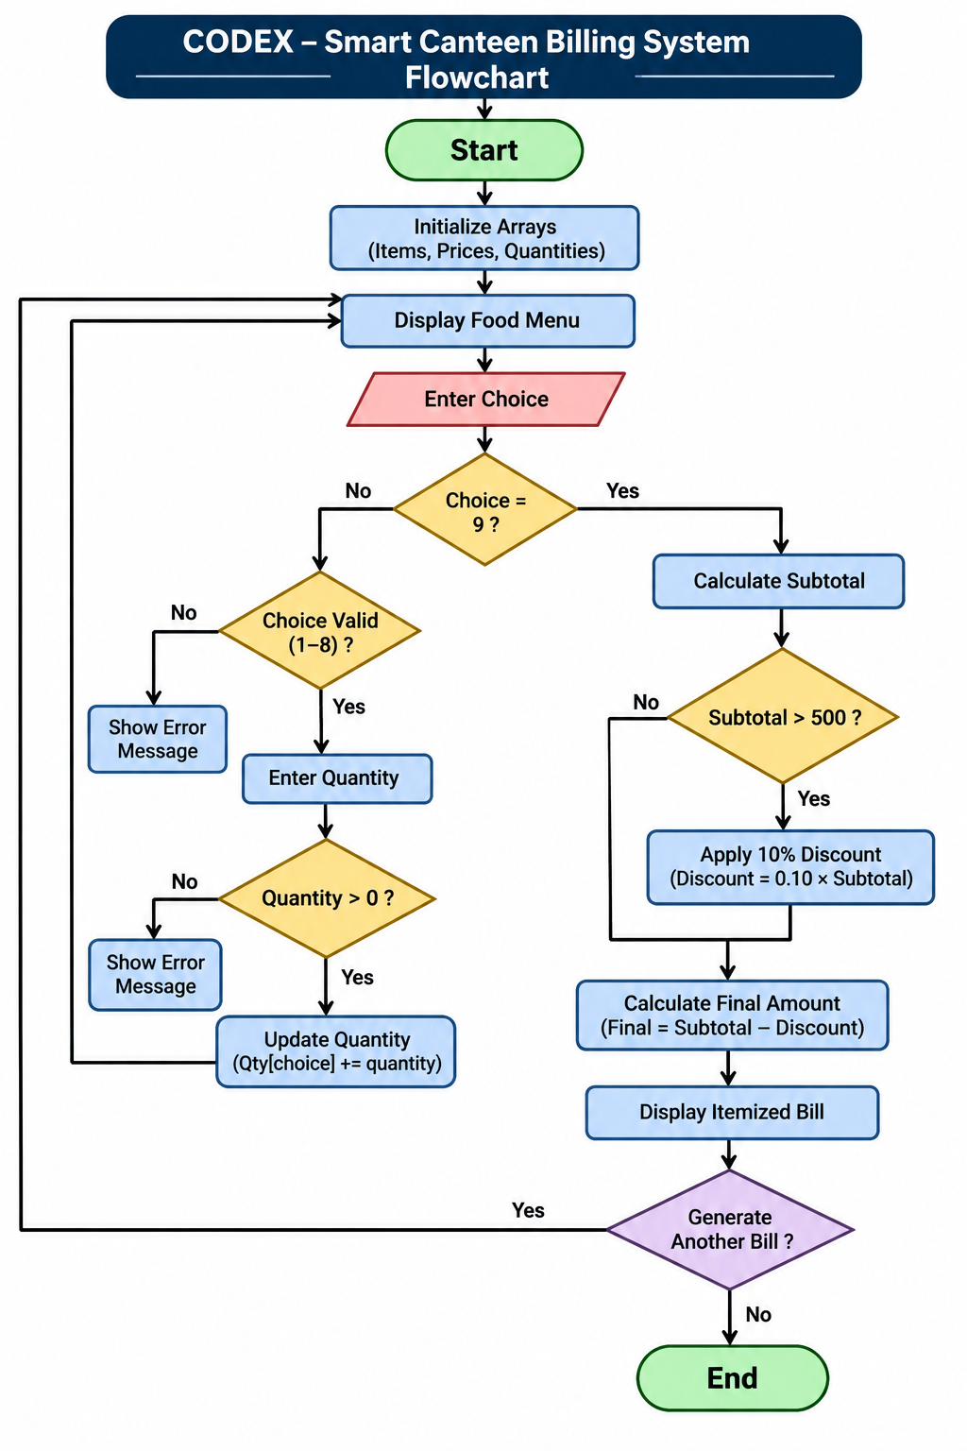

Slide 9
C concept used:-
Concept | Application
Variables | Store choices, quantities and bill amounts
Data Types | int and float
Arrays | Store prices and quantities
Strings | Store food item names
If-else | Validate inputs and check discounts
For loop | Calculate and display bill
While loop | Accept multiple orders
Do-while loop | Repeat billing sessions
Break | Exit the ordering loop
Continue | Skip invalid entries
printf() | Display information
scanf() | Accept user input

Slide 10
~Implementation~
1. Menu Initialization
Stores food names and their prices in arrays.
2. Order Management
Accepts food choices and quantities.
Stores quantities in the quantity array.
3. Bill Calculation
Multiplies item prices by quantities.
Calculates the subtotal.
4. Discount Calculation
Checks whether the subtotal is greater than ₹500.
Applies a 10% discount if the condition is satisfied.
5. Bill Generation
Displays ordered items, quantities, costs, subtotal, discount and final amount.

Slide 11
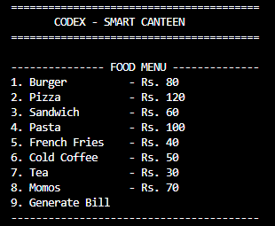
~Working~
Menu….

Slide 12
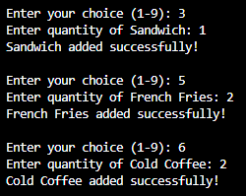
Selecting food options:

Slide 13
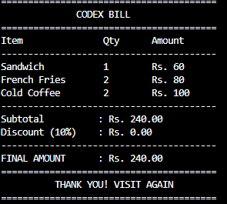
Generating Bill :

Slide 14
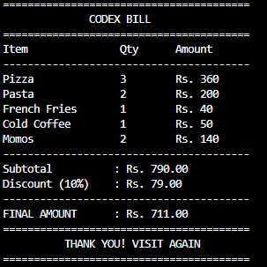
Discount:
Example 1: Discount Calculations
Sub Total = 799.00
Amount > 500
Discount(10%) = 79.00
Final amount = 711.00

Slide 15
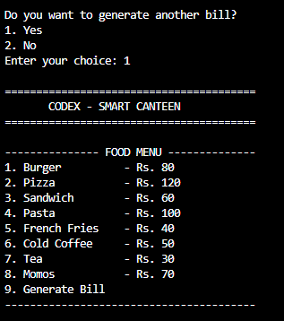
Generate Another Bill

Slide 16
~Sample testing~
Test Case | Expected Result
Valid food selection | Item selected successfully
Multiple food selections | All selected items added
Same item selected twice | Quantities combined
Invalid menu choice | Error message displayed
Zero quantity | Invalid quantity message
Bill below ₹500 | No discount
Bill above ₹500 | 10% discount
Generate another bill | Fresh bill starts

Slide 17
THANK YOU!!!

